Slide 1
Welcome to
Air Force Financial Readiness:
Permanent Change of Station (PCS)
Personal Financial Readiness

Slide 2

Straw Poll
How far did you move?
  0-100 miles
  101-500 miles
  501-1000 miles
  1000+ miles

Slide 3
Straw Poll
How long did the move take you?
1 day
2-4 days
5-6 days
7+ days

Slide 4
Straw Poll
How much did moving cost you out of pocket?
0-$200
$201-$500
$501-$1,000
$1000+

Slide 5
Straw Poll
Thinking ahead to your next move, how expensive do you expect it to be?
  Less
  More

Slide 6
Straw Poll
Thinking ahead to your next move, on a scale of 1 (not very) to 10 (very), how stressful do you expect the move to be?
1 2 3 4 5 6 7 8 9 10

Slide 7



Agenda
PCS Expenses
PCS Resources
Financial Planning
for PCS
7

Slide 8


PCS Expenses

Slide 9


I’m Going to ____ (Disneyland?)
Financial obligations to clear
Financial obligations during transition
Financial obligations upon arrival
Financial reserves
Plans for cash flow changes
Plans to change banks
Plans for household income changes
Notes:
Animation – 7 clicks

Slide 10


Expenses Before Your Move
House hunting
Moving out
Exceeding weight limit
Household goods storage
Insurance
Notify creditors
Miscellaneous expenses
Loss of spouse’s income
Medical and dental
Pets
Passports and visas
Vehicle preparation
Vehicle transportation
Vehicle storage
Leased vehicles
Notes:
Animation – 11 clicks

Slide 11

Expenses in Transit
POV driving costs
Overnight accommodations
Food and miscellaneous
Recreation
Notes:
Animation – 4 clicks

Slide 12

Expenses at the New Duty Station
Temporary lodging and food
Laundry
Utility deposits
Cell phones
Rental deposits
Supplies
Insurance
Car registration, licenses, taxes
State residency
Miscellaneous
Notes:
Animation – 6 clicks

Slide 13

Child Care
Availability: on-base and/or off-base
Cost
Locations
Sources of help:
  Military installations website
  Sponsors
  A&FRC
  Militarychildcare.com
  AFAS
Notes:
Animation – 3 clicks

Slide 14

Emergency/Reserve Savings

Slide 15

Pass it On
Have a yard sale
Change your address
Automate bill paying
Get a credit report
Get reference letters
Establish checking/savings accounts
Get preapproved for a mortgage
Use military facilities
Notes:
Animation – 8 clicks

Slide 16

PCS Resources

Slide 17
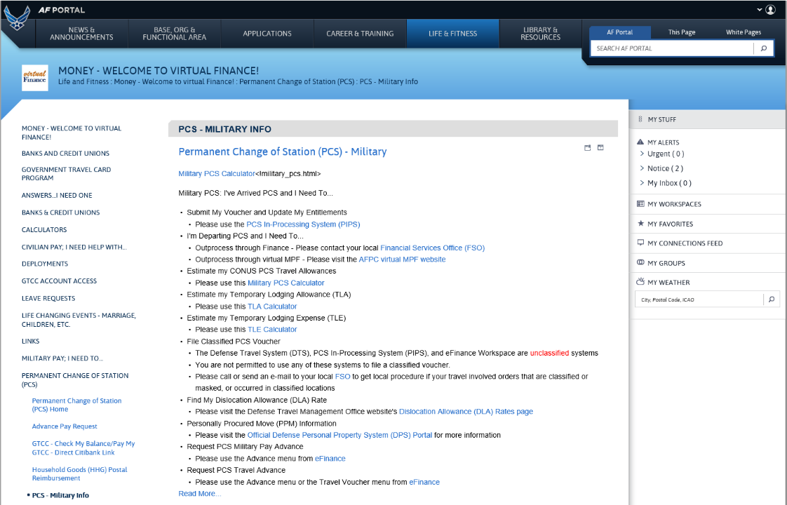
Air Force Portal – Virtual Finance
https://www.my.af.mil/

Slide 18
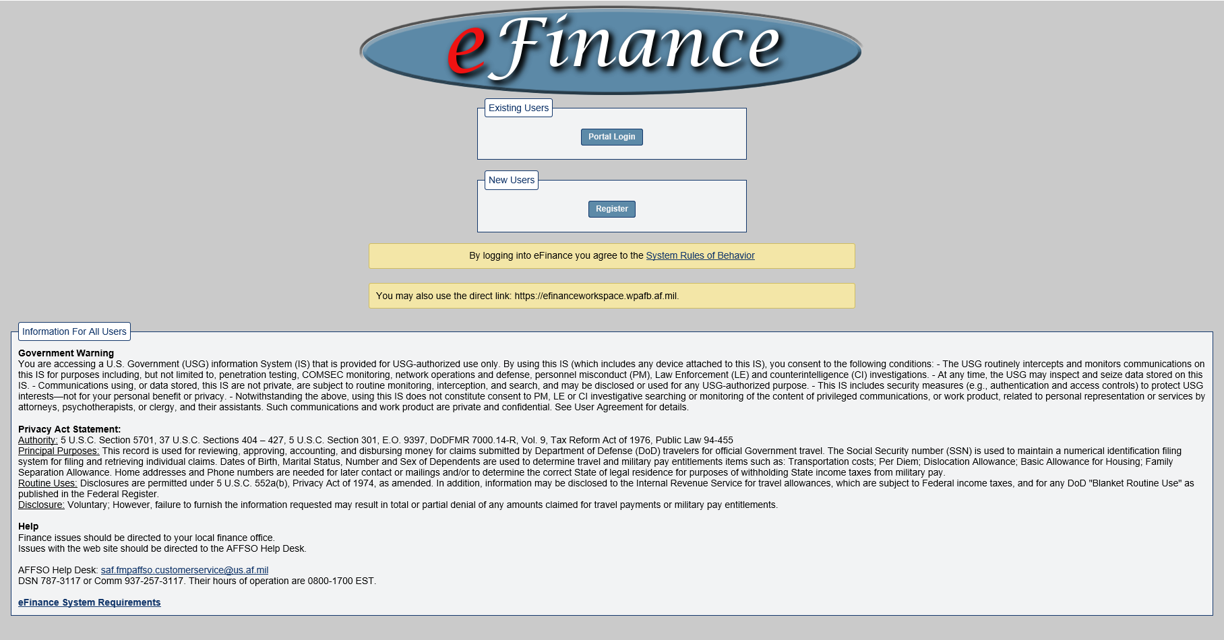
Air Force Portal – eFinance
https://www.my.af.mil/

Slide 19

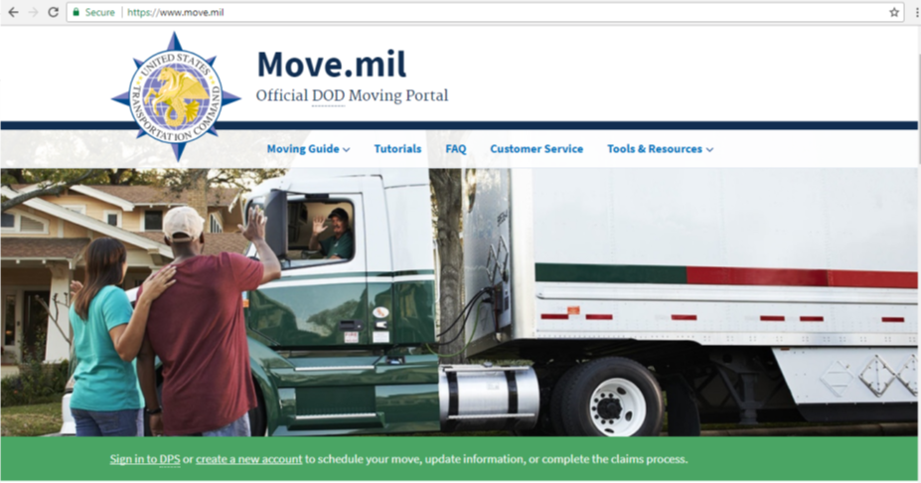

Move.mil

Slide 20

Travel Pay and Allowances
OHA? COLA? MIHA? TLE? TLA?
Find out the pays and allowances that apply to your move at base Finance Office and TMO.
Use of Government Travel Charge Card (GTCC) is authorized, but be aware of restrictions.
Notes:
Animation – 2 clicks

Slide 21

Requesting Advance Pay and Allowances
Not authorized for reimbursable expenses
Repayment can affect income for 12 months or more
Budget for repayment
Be aware of associated risks and downsides

Slide 22

Financial Planning for PCS

Slide 23
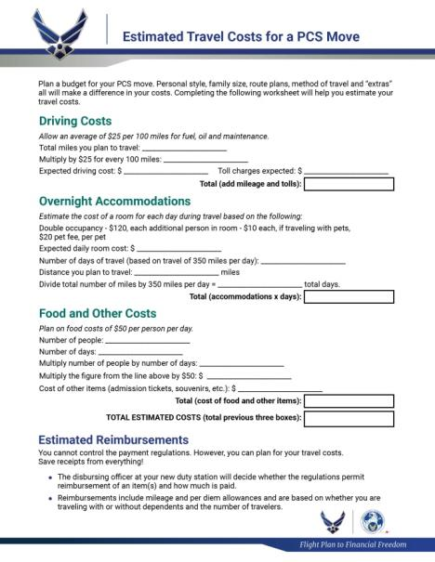
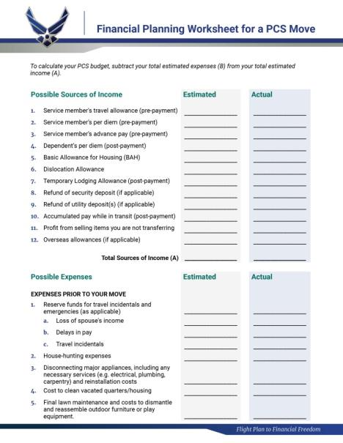
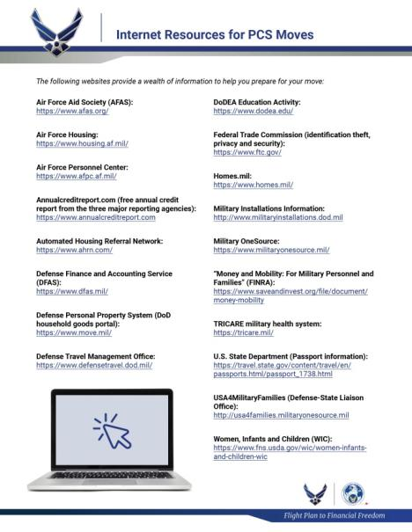

PCS Planning Worksheets

Slide 24

Do the Math

Slide 25

Sources of Help
Command Sponsor
Personal Financial Counselor/Educator
Military OneSource
Traffic Management Office
Financial Support Office
Virtual Finance
eFinance
Air Force Aid Society

Slide 26

Tic-Tac-Go!

Slide 27




Summary
The key to a successful move: Planning.
Consider all moving expenses.
Review finances and spending plans.

Slide 28

Conclusion
Evaluations and Certificates
Thank you!

